Slide 1
New Zealand FAM
Social Media Bootcamp

Slide 2


Agenda
Social Media Before, During & After FAM
Tag Places and Things
Hashtags
Instagram Review
TLN Social Studio & Resources
Social Share
New Zealand Cultural Considerations
Social Media Guide

Slide 3
TLN Digital Marketing Team
Sara Lanto, Director of Digital Marketing and the resident social media guru.
Lisa Alitz, Marketing Specialist

Slide 4
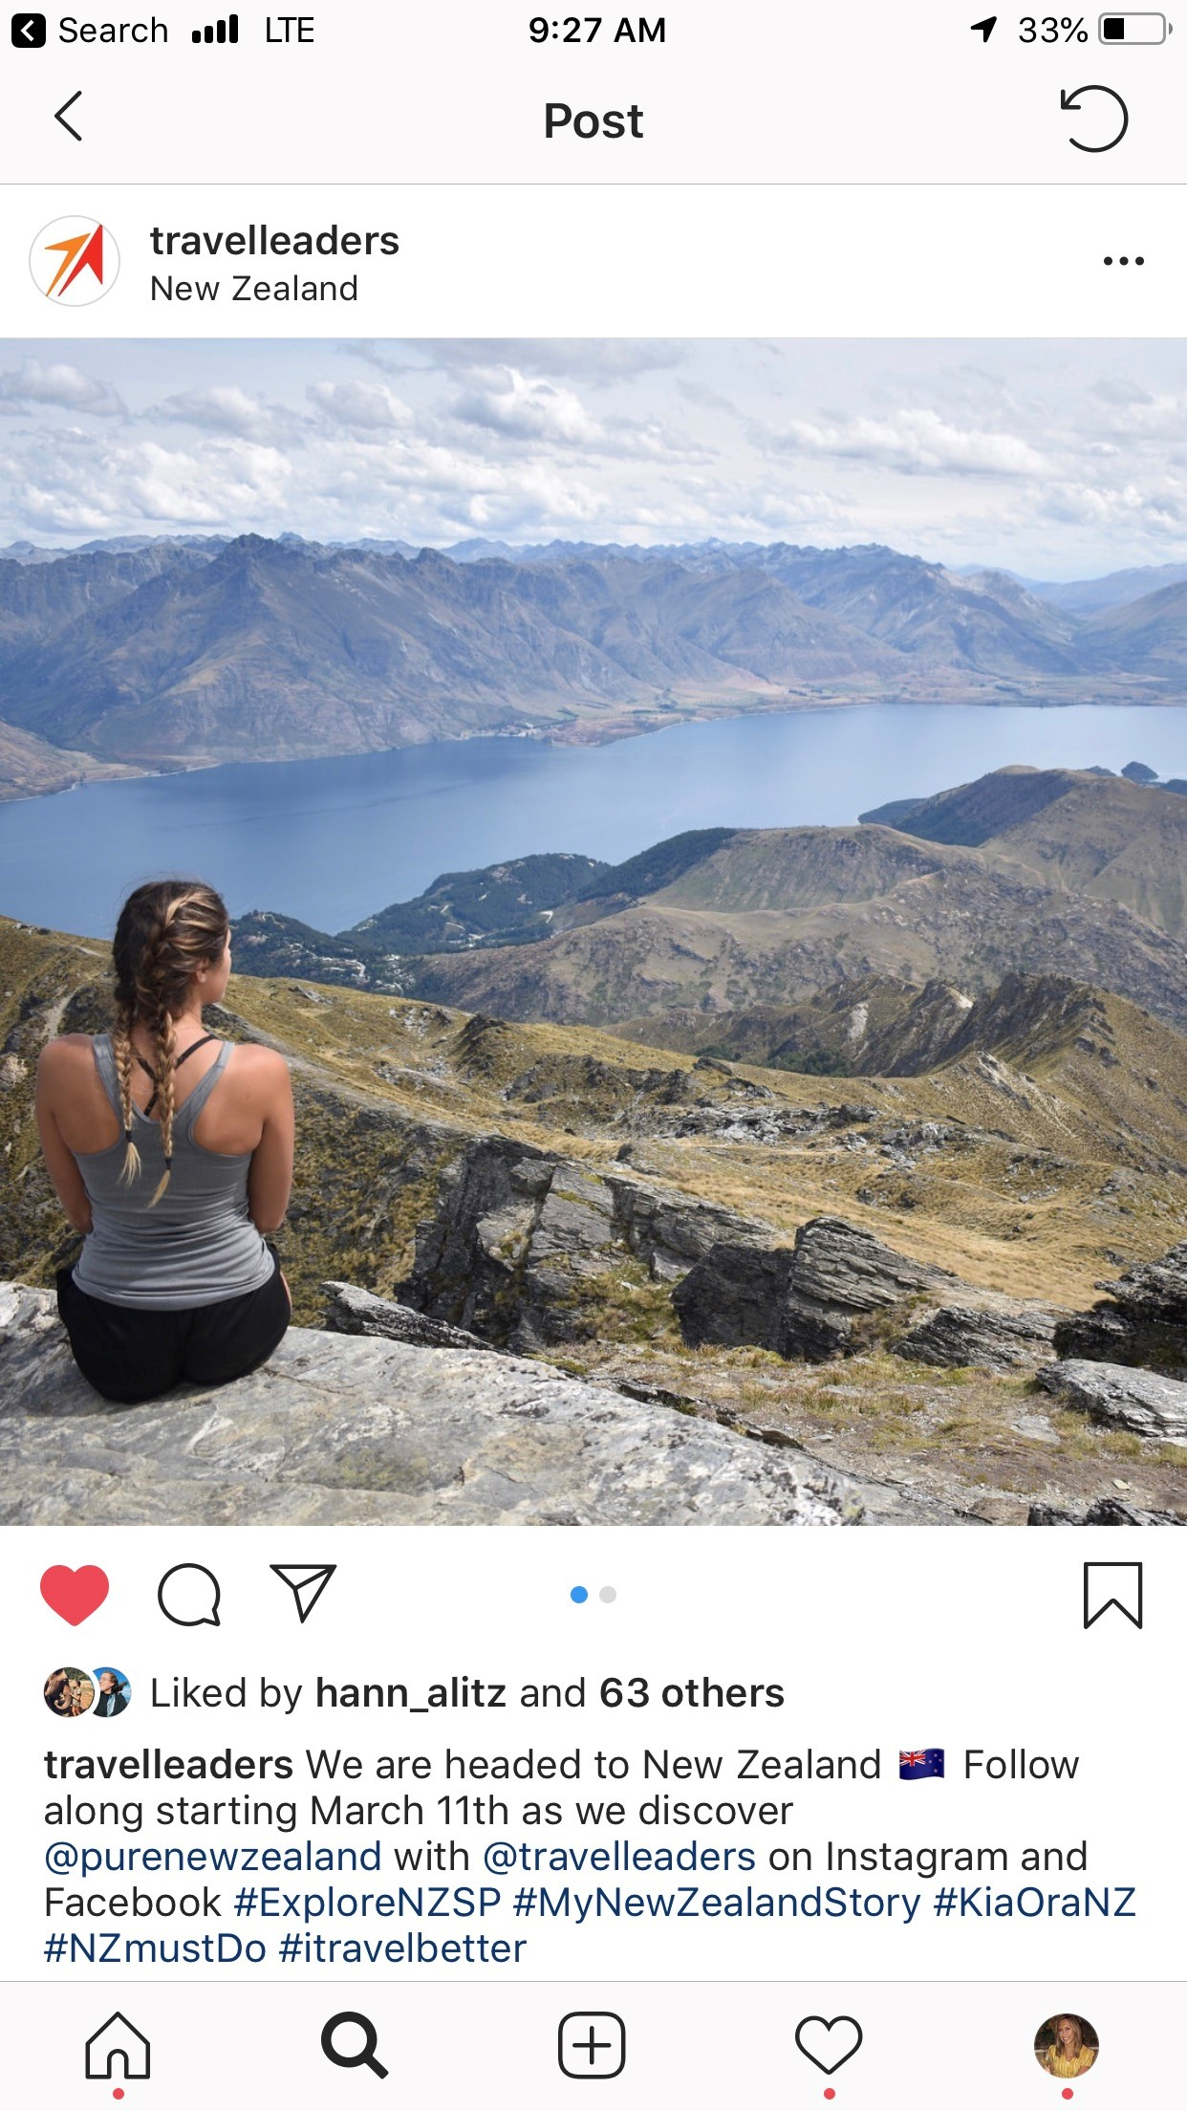
Social Media Timeline
Before, During & After the FAM
  Before – tell your clients you are going, create excitement and have them follow you.
  During – Post experiences, suggestions and tips.
  After – Facebook live, schedule it before you go and then talk about your trip!

Slide 5
Social Media Tips
#ExploreNZSP
#MyNewZealandStory
#KiaOraNZ
#NZMustDo
#itravelbetter
#Travel2US
Content – Video & Pictures
  Top 4 B’s: Be yourself, Be authentic, Be creative, Be different
Tagging – Places & Things
Hashtags – What they are, how to use them

Slide 6
How to Post on Instagram
Choose 1-10 quality images to post on Instagram
Add filters or edit your photos if desired
Write a caption for your photo that explains the photo
  Tell a story, include a call to action, use emojis 😄
Mention other brands accounts: @purenewzealand & @travelleaders
Add hashtags: #mynewzealandstory #kiaoranz #nzmustdo #itravelbetter
Tag people in your photo
Add location
Share to Instagram

Slide 7
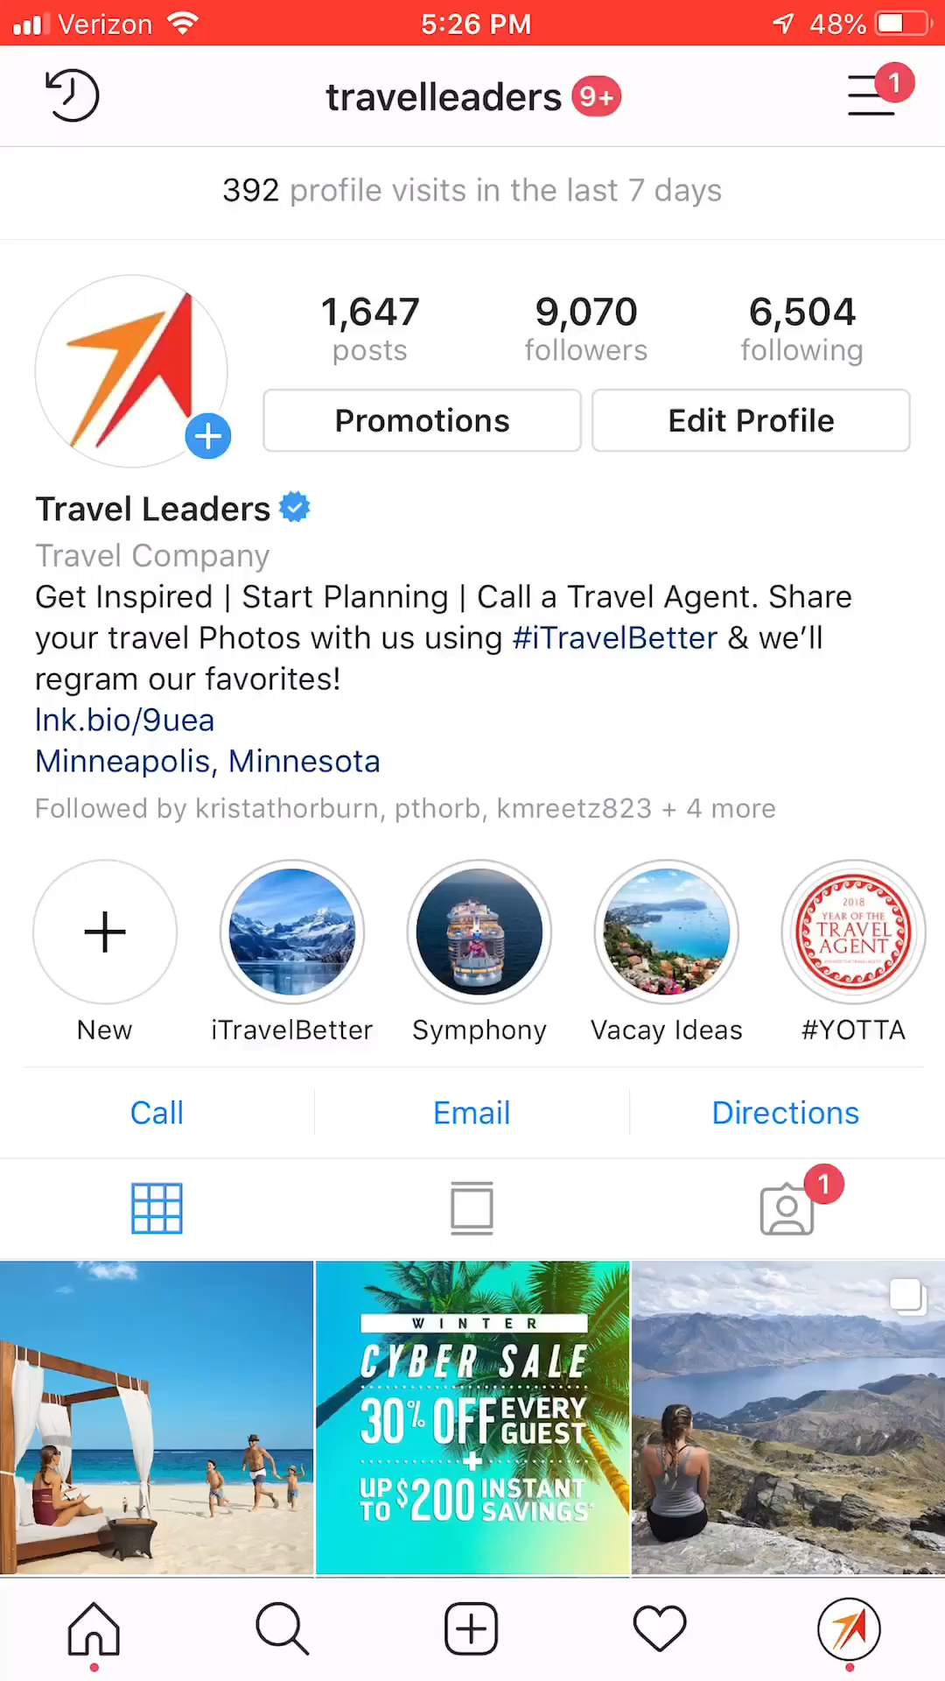
Example Post on Instagram

Slide 8
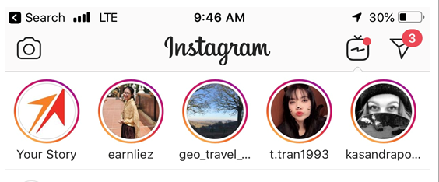
How to Post a Instagram Story
Instagram Stories allows you to create media that appears at the top of your followers’ news feeds for 24 hours.
You can record live video or take photos with your smartphone.
Tap on the circled button at the top left of your Instagram screen. Hold & click Add to Your Story.
Add text or draw on your photos using the options on the top right of the screen.
Add locations and extra icons using the options on the top right of the screen.
Once you’re satisfied, tap on the checkmark at the bottom to add the photo or video to your story.

Slide 9
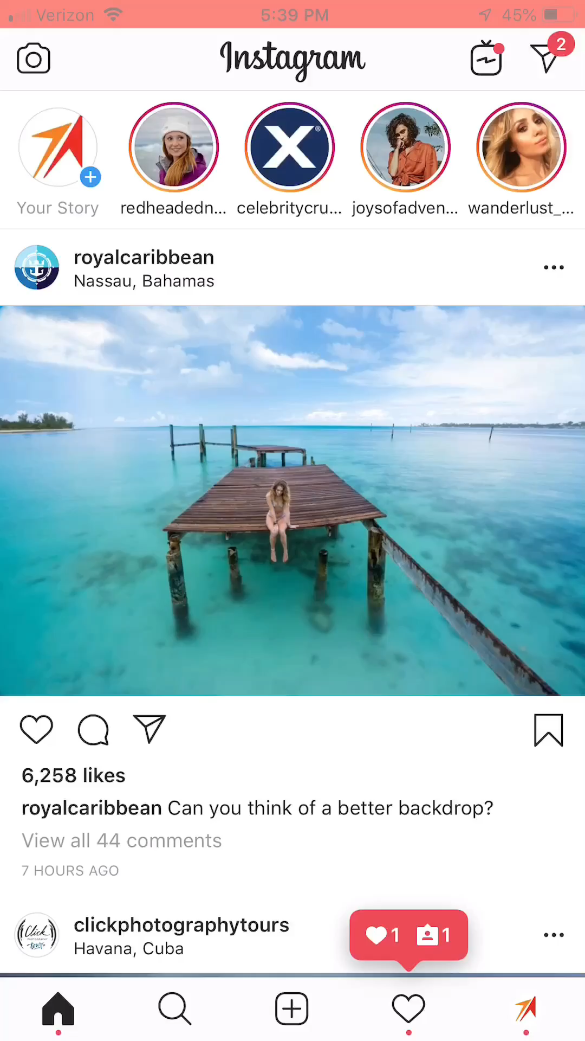
Example of a Instagram Story

Slide 10
Importance of Instagram & Facebook Live
Travel is all about the experience of being some place special
Tap in the top left of the screen or swipe right from anywhere in Feed.
The number of viewers appears at the top of the screen and comments appear at the bottom.
What to do on LIVE?
  Tell a Story – There are probably a ton of cool stories around the area your are traveling – bring one to your followers!
  Interview other people - Just find people who are having fun and get them to share details of their adventures – you’ll share, they’ll share – everyone wins!
  Virtual Tours - Whether you are at a resort or other locations it gives people a sense of the environment. Do a 360 LIVE of the place you are in!

Slide 11
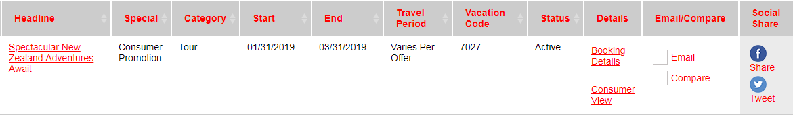
TLN Social Media Resources
Type in the questions box – Yes or No, you have a published profile on Agent Universe.
Social Studio
Social Share

Slide 12
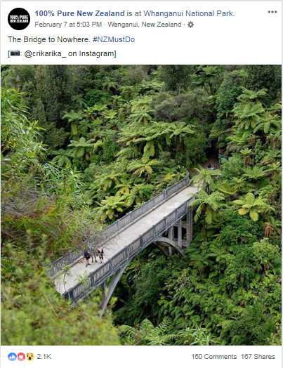
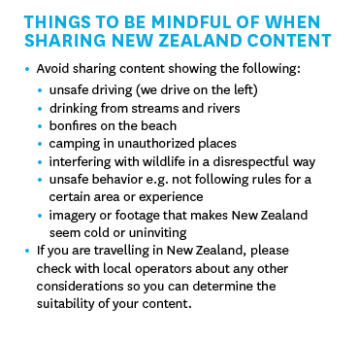
New Zealand Cultural Considerations

Slide 13
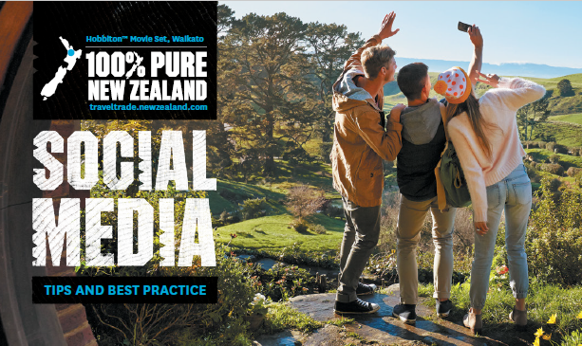
In Summary
GOAL - Be prepared to maximize your social media reach and impact as it relates to selling New Zealand
Social Media Guide & Recording
In Country Support
Contest
Any Questions?

